Slide 1
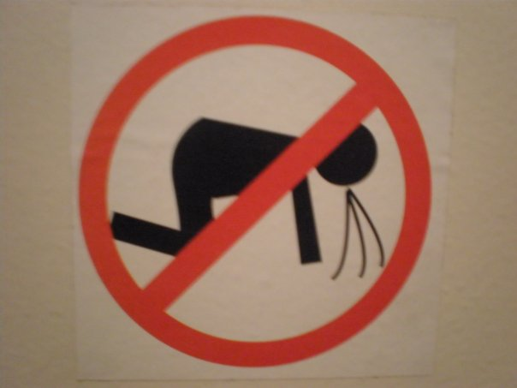
Sudden Illness

Slide 2
Sudden Illness
Introduction
Think back to a time when you had a sudden illness or have witnessed someone who became suddenly ill.
Did you/victim remain conscious or loose consciousness?
What did it feel like/what happened?
Did you/victim have to go to the hospital?

Slide 3
Sudden Illness
Students will be able to:
1. Identify general signals of sudden illness.
2. Identify signals and steps for care of specific
illness including fainting, stroke, seizure,
poisonings, allergic reactions and diabetes.
3. Identify signals of heat illness and provide
care.
4. Identify signals of cold illness and provide
care.

Slide 4
Sudden Illness
Signs & Symptoms of Sudden Illness:
Changes in consciousness
Slurred speech, difficulty speaking
Persistent pain or discomfort
Nausea or vomiting
Numbness or weakness

Slide 5
Sudden Illness
Signs & Symptoms of Sudden Illness:
Changes in skin color
Loss of coordination or balance
Changes in vision
Changes in breathing
Sweating

Slide 6
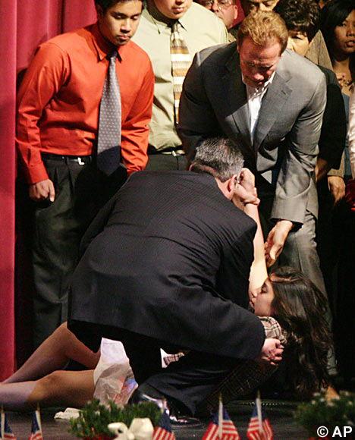
Sudden Illness
Fainting
Signals
  Change in skin color
  Victim suddenly loses consciousness
  Usually reawaken
  Usually quickly recover

Slide 7
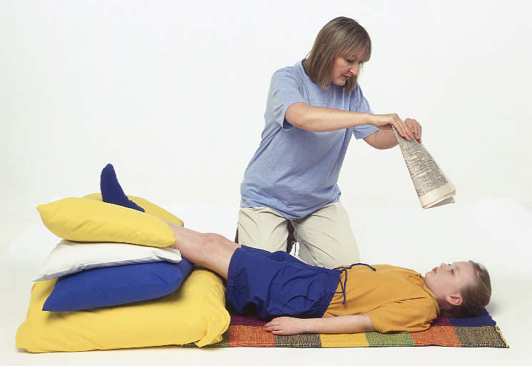
Sudden Illness
Fainting
Care
  Assist victim to ground
  If possible elevate victim’s legs about 12 inches
  Place on side if victim vomits
  Monitor ABCs
  Call 911 if no improvement

Slide 8

Sudden Illness
Terminology
Stroke
Disruption of blood flow to part brain due to a clot or vessel breakage. Demonstrates symptoms on one side of the body.

Slide 9
Sudden Illness
Stroke
Care
FAST:
  Face: check face movement by having victim
  smile
  Arm: have victim raise both arms
  Speech: have victim say something to see if
  there is a change in speech
  Time: note time symptoms began

Slide 10
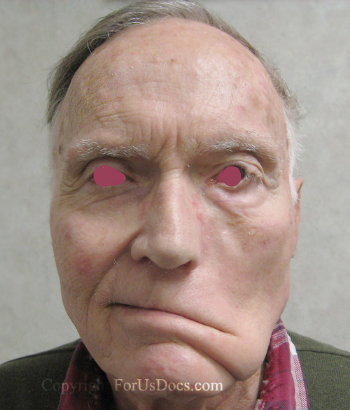
Sudden Illness
Stroke
Care
If you suspect a stroke,
Call 911 – ASAP
Time is critical
  Provide care for symptoms

Slide 11
Sudden Illness
Seizures
An abnormal electrical chemical reaction in the brain
Seizures can be caused by illness, injury, fever and pregnancy
Can be anything from a Petite to a Grand Mal
If person is known to have occasional Seizures, you do NOT need to call 911

Slide 12
Sudden Illness
Seizures
Care
Care for the person the same way you would for an unconscious person
Lower victim to ground and remove nearby objects that may cause harm
DO NOT PLACE ANYTHING IN VICTIM’S MOUTH
DO NOT HOLD PERSON DOWN OR RESTRAIN

Slide 13
Sudden Illness
Seizures
Care
Protect victim’s head by placing something soft under it
If victim vomits, place him/her on one side for mouth to drain
Monitor victims ABCs as seizure ends and provide appropriate care

Slide 14
Sudden Illness
Seizures
Care - Seizures that need a 911 call
Seizure that lasts more than 5 minutes
Repeated, multiple seizures
Injury to victim
Uncertain about cause of seizure
Victim is pregnant, diabetic, infant or child
Fails to regain consciousness after seizure

Slide 15

Sudden Illness
Failure of the circulatory system to provide oxygen rich blood to vital organs

Slide 16
Sudden Illness
Shock
When vital organs, brain, heart & lungs, do not receive enough blood, they fail to function properly.
Triggers shock, which is body’s attempt to maintain adequate blood flow.

Slide 17
Sudden Illness
Shock
Signals
Restlessness or irritability
Skin – pale or ashen, cool & moist
Nausea or vomiting
Rapid breathing
Pulse – rapid and weak
Changes in the level of consciousness

Slide 18
Sudden Illness
Shock
Care
Call 911
Have person lie down & rest comfortably
Elevate person’s legs about 12”
Regulate body temperature
Control external bleeding

Slide 19
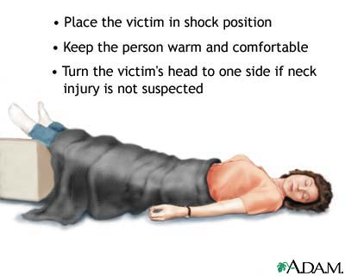
Sudden Illness
Shock
Care

Slide 20
Sudden Illness
Shock
Care
Do not give anything to eat or drink
Reassure the person
Monitor ABC’s
Do no harm

Slide 21
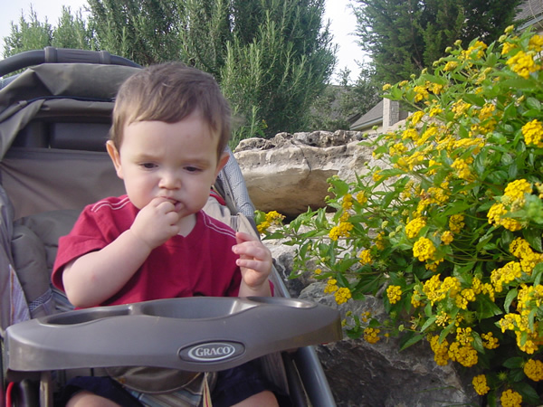
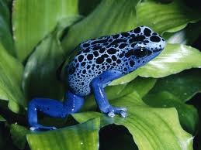
Sudden Illness
Poison
Any substance that causes injury, illness or death when introduced into the body.

Slide 22
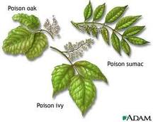
Sudden Illness
Poison
Poisons can be:
  Inhaled
  Injected
  Absorbed
  Ingested
Poison victims will show signs of sudden illness

Slide 23
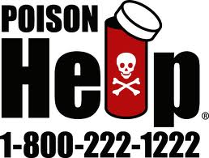
Sudden Illness
Poison
Care
Remove them from source
Call Poison Control:
National: 1-800-222-1222
Arizona: 1-800-362-0101
Poison Control will give instructions for care or initiate EMS

Slide 24
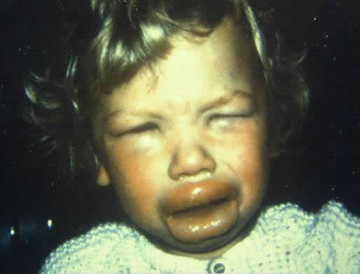
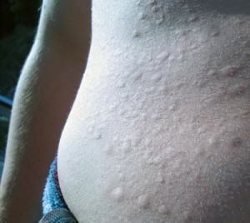
Sudden Illness
Terminology
Anaphylaxis – severe allergic reaction

Slide 25
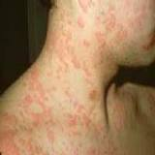
Sudden Illness
Anaphylaxis
Signs & Symptoms
  Hives, itching or rash
  Nausea or vomiting
  Dizziness
  Breathing difficulty

Slide 26
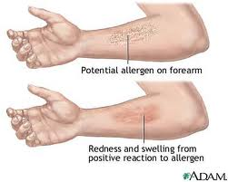
Sudden Illness
Anaphylaxis
Signs & Symptoms
  Swelling
  Low blood pressure
  Shock
  Scared & Apprehensive

Slide 27
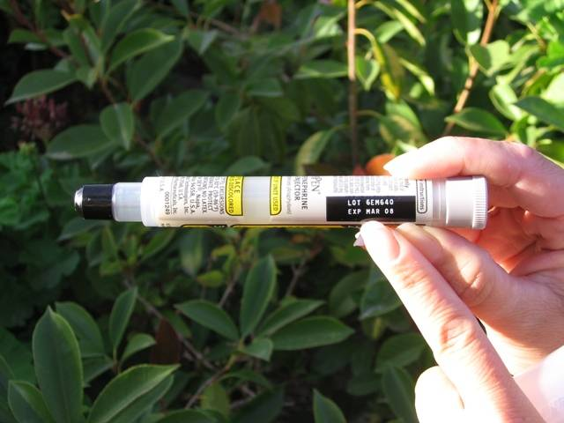
Sudden Illness
Anaphylaxis
  Care
  Call 911
  Victim should rest
  Monitor ABCs
  Loosen restrictive clothing
  Assist victim if he/she has an epinephrine pen

Slide 28
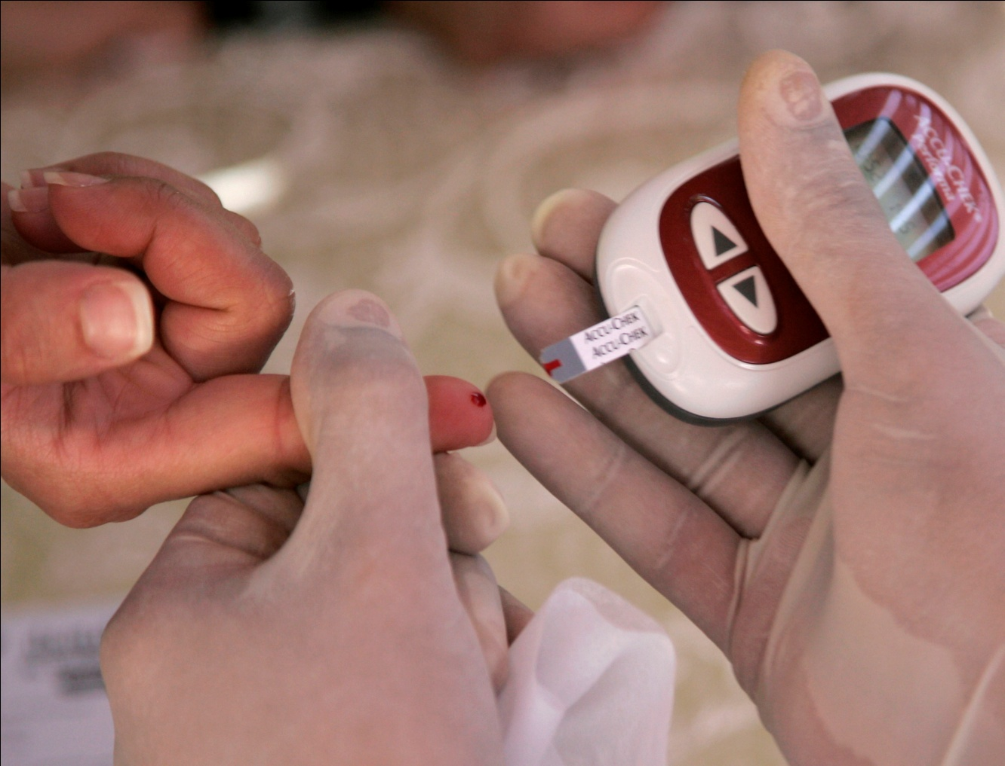
Sudden Illness
Terminology
Diabetes
Disease in which the body cannot produce enough insulin to control
the amount of sugar in the blood.
Insulin regulates blood sugar

Slide 29
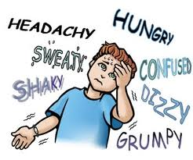
Sudden Illness
Diabetes
Most diabetic emergencies are due to too
much insulin in body & not enough sugar
Victims will get drowsy, confused and not
feel well

Slide 30
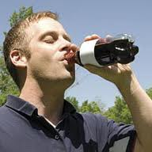
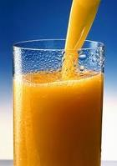
Sudden Illness
Diabetes
Care
Give victim some form of sugar (juice, soda)
Call 911
  If no improvement
  If no sugar available
  If victim goes or is going unconscious

Slide 31
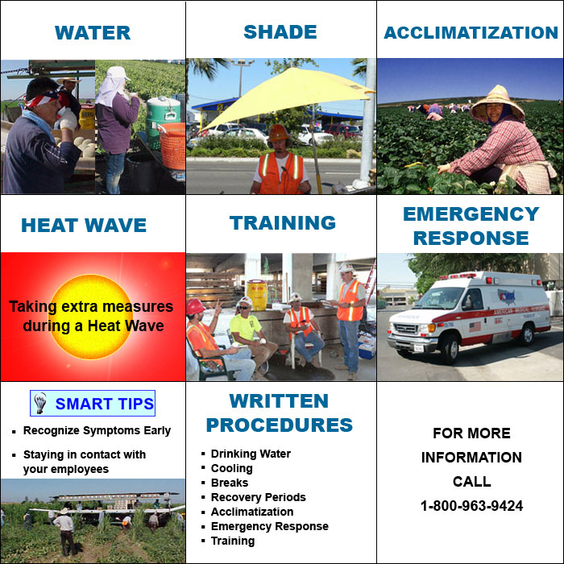
Sudden Illness
Terminology
Heat Illness
Elevated body temperature due to dehydration, physical activity & hot &/or humid environmental conditions.

Slide 32
Sudden Illness
Terminology
Heat Illness
Can include heat cramp, heat exhaustion or heat stroke and can result in death.

Slide 33
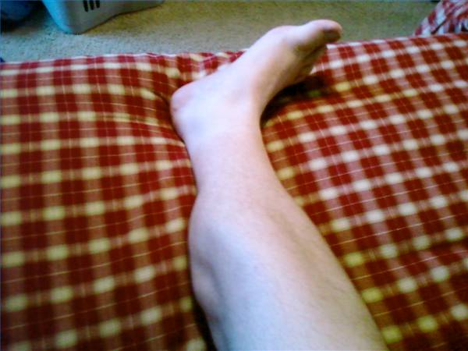
Sudden Illness
Terminology
Heat Cramps
Involuntary muscle contractions that are caused by a combination of dehydration and fatigue.
First sign of heat illness

Slide 34
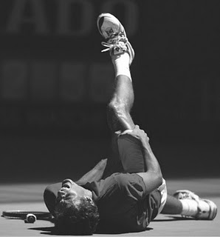
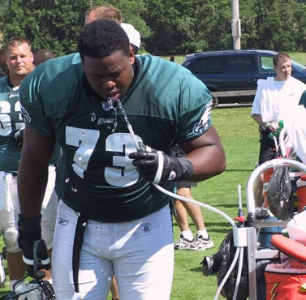
Sudden Illness
Heat Cramps
  Care
  Stretch/massage muscle
  Drink plenty of cold fluids
  Rest

Slide 35

Sudden Illness
Terminology
Heat Exhaustion
Condition in which victim appears exhausted
due to dehydration, sweating & electrolyte loss.

Slide 36
Sudden Illness
Heat Exhaustion
S & S
Fatigue
Dizziness
Headache
Sweaty, moist
skin
Nausea
More severe than heat cramps

Slide 37
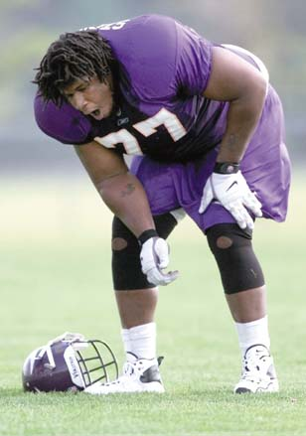
Sudden Illness
Terminology
Heat Stroke
Extremely high body temperature that leads to unconsciousness and death. Body can no longer cool itself.
Kory Stringer

Slide 38
Sudden Illness
Terminology
Heat Stroke
S & S
Dry or moist red
skin
Change in
consciousness
Rapid weak
pulse
Rapid shallow
breathing
A MEDICAL EMERGENCY!

Slide 39
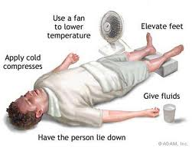
Sudden Illness
Care for Heat Exhaustion & Heat Stroke
Remove victim from heat source
Remove restrictive clothing
Cool victim with cold wet towels or cloths
Encourage victim to drink water, if conscious
Fan victim

Slide 40
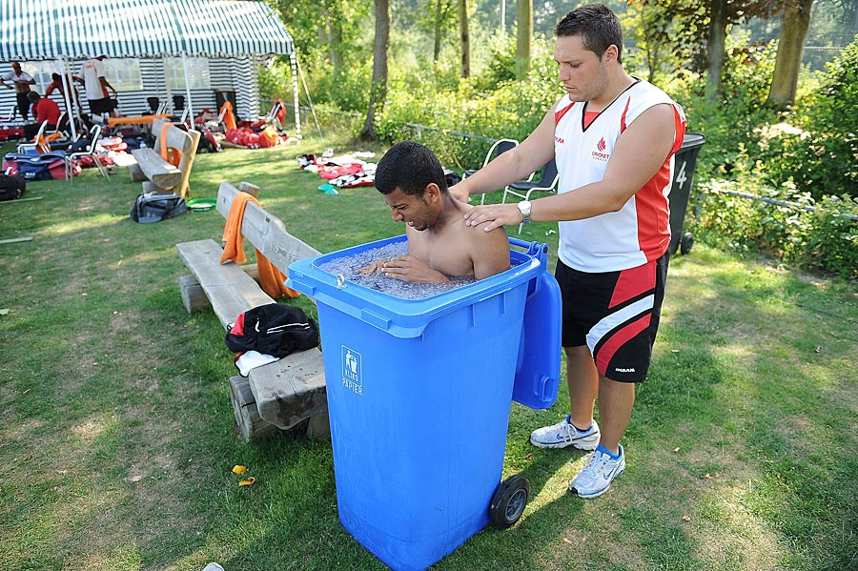
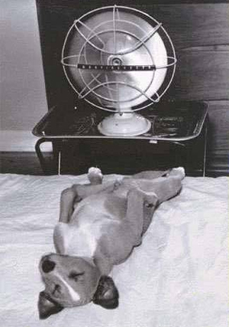
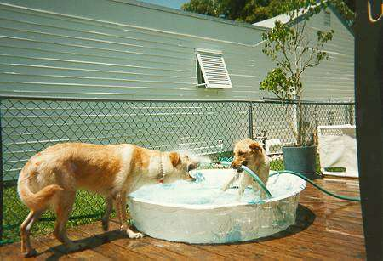
Care for Heat Emergencies

Slide 41
Sudden Illness
Care for Heat Exhaustion & Heat Stroke
Call 911 if:
  Victim vomits severely
  Refuses water
  Victim goes unconscious
  Victim’s condition does not improve with care

Slide 42
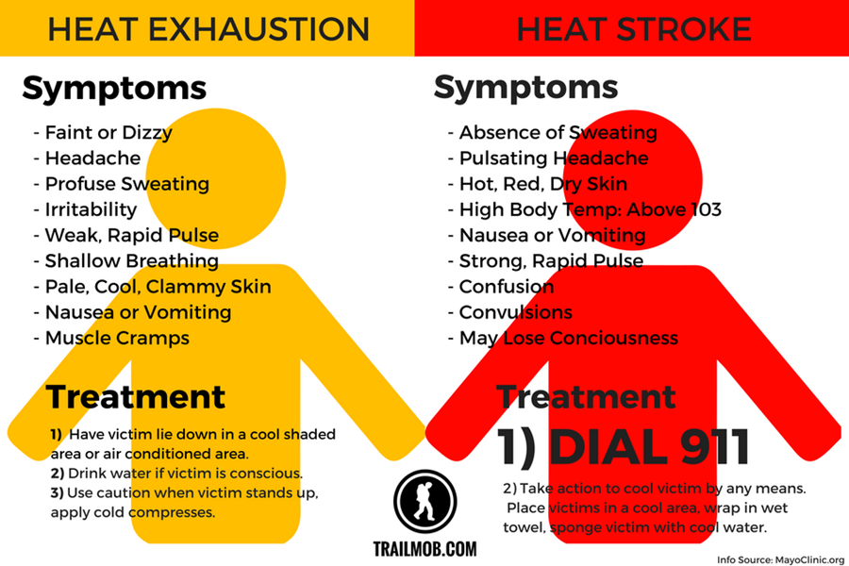

Slide 43
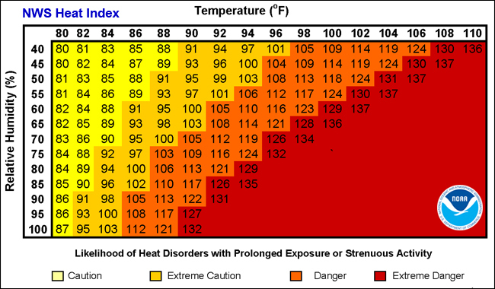

Slide 44
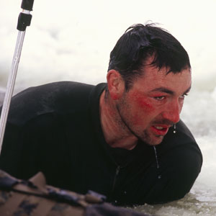
Sudden Illness
Terminology
Cold Illness
Lowering of body temperature due to cold/wind/ wet. Does not have to be very cold. Can cause tissues to freeze and can result in death.

Slide 45
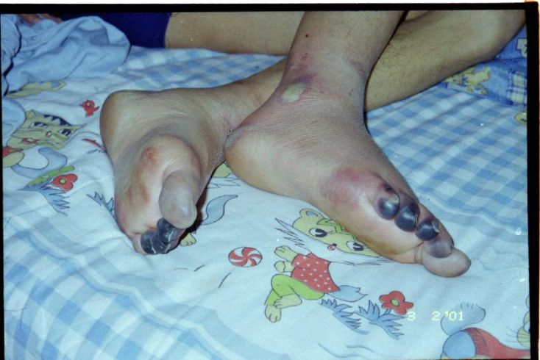
Sudden Illness
Terminology
Frostbite
An extreme example of cold illness, due to prolong exposure to cold temperatures. Tissues freeze and may lead to tissue death.

Slide 46
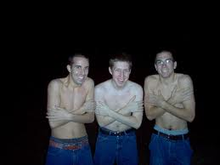
Sudden Illness
Signs & Symptoms
  Shivering
  Slurred speech
  Loss of coordination
  Slow thinking
  Loss of
  consciousness
Hypothermia
The entire body cools
Person will die if not given care

Slide 47
Sudden Illness
Care for Hypothermia
  Remove from cold
  Remove wet clothing
  Re-warm gradually (layers of clothing or heat)
  If conscious give warm beverages
  Call 911 for frostbite or if no improvement
  Do not rub frostbite – re-warm slowly
  Do NOT let it re-freeze

